Slide 1
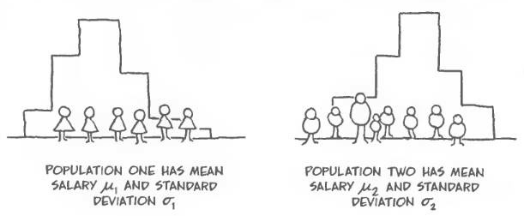
Paired Samples T-Test
Chapter 8 Part 1
Dr. Abolfazl Saghafi
Assistant Professor of Statistics & Data Science
Data Science Program Director
Notes:
Testing for two dependent means

Slide 2
Independent Vs Dependent
Two samples are independent if the sample values selected from one population are not related to or somehow paired with the sample values selected from the other population.
Ex: One group of subjects is treated with the cholesterol reducing
drug Lipitor, while a second and separate group of subjects is given a placebo.
Two samples are dependent if the members of one sample are paired with the members of the other sample or measurements are gathered for one individual at two different stages.
Ex: The effectiveness of a diet is tested using weights of subjects measured before and after the diet treatment.

Slide 3


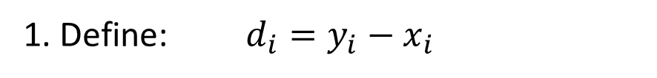

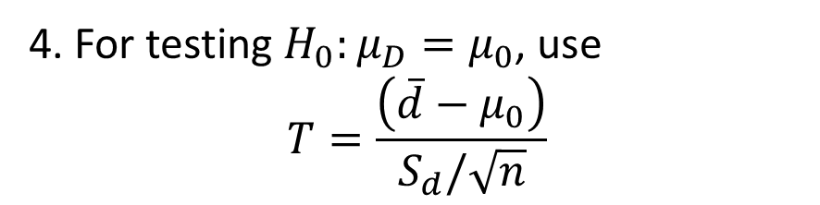
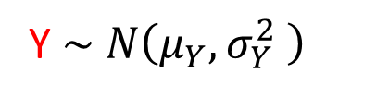
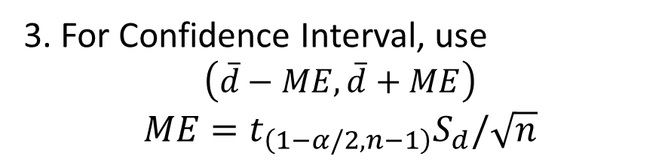
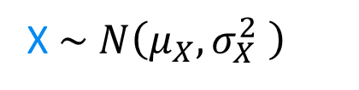
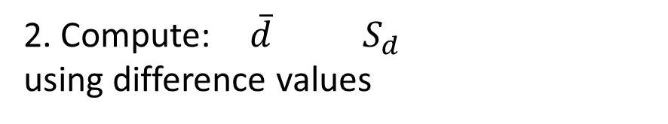
Dependent Samples
Population 1
Variable of interest: X
Population 2
Variable of interest: Y
Examples include:
* Pre and Post experiments
* Study on Twins
* Repeated measurements through time
X $\sim N\left(μ_{X},σ_{X}^{2} \right)$
Y $\sim N\left(μ_{Y},σ_{Y}^{2} \right)$
Unknown
1. Define: $d_{i}=y_{i}−x_{i}$
We are interested in inference on the difference $μ_{D}=μ_{Y}−μ_{X}$
2. Compute: $\overline{d}$ $S_{d}$
using difference values
$$⇓$$
3. For Confidence Interval, use
$$\left(\overline{d}−ME,\overline{d}+ME\right)$$
$$ME=t_{\left(1−α/2,n−1\right)}S_{d}/\sqrt{n}$$
Sample of size n
from PAIRED values
4. For testing $H_{0}:μ_{D}=μ_{0}$, use
$$T=\frac{\left(\overline{d}−μ_{0}\right)}{S_{d}/\sqrt{n}}$$
$$\left(x_{1},y_{1}\right),\left(x_{2},y_{2}\right),…,\left(x_{n},y_{n}\right)$$
Notes:
$μ_{0}$ is usually 0 since we are usually interested in testing whether the Y scores are any different from X scores
If we want to see whether Y scores are generally greater than X scores, then $μ_{0}$ is a positive number which should be mentioned in the problem

Slide 4

Ex1. Self-Reported and Measured Female Heights
As part of the National Health Survey conducted by the DHHS, self-reported heights and measured heights were obtained for females aged 12–16. Listed below are sample results in inches.
Is there sufficient evidence to support the claim that there is a difference between self-reported heights and measured heights of females aged 12–16? Use a 0.05 significance level.
Reported height: 53 64 61 66 64 65
Measured height: 58.1 62.7 61.1 64.8 63.2 66.4
Reported height: 68 63 64 64 64 67
Measured height: 67.6 63.5 66.8 63. 9 62.1 68.5

Slide 5




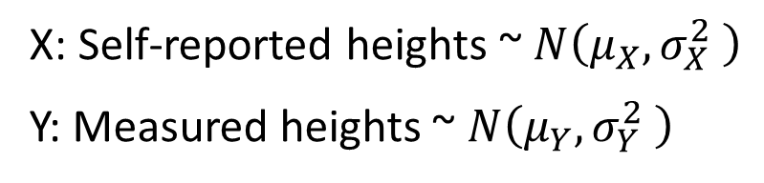

X: Reported height: 53 64 61 66 64 65
Y: Measured height: 58.1 62.7 61.1 64.8 63.2 66.4
Difference 5.1 -1.3 0.1 -1.2 -0.8 1.4
X: Reported height: 68 63 64 64 64 67
Y: Measured height: 67.6 63.5 66.8 63. 9 62.1 68.5
Difference -0.4 0.5 2.8 -0.1 -1.9 1.5
X: Self-reported heights ~ $N\left(μ_{X},σ_{X}^{2} \right)$
Y: Measured heights ~ $N\left(μ_{Y},σ_{Y}^{2} \right)$
Although nothing is mentioned about normality, this assumption is valid in terms of height
Parameter of interest here is
$$μ_{d}=μ_{Y}−μ_{X}$$
$$n=12$$
$$\overline{d}=0.475$$
$$s_{d}=1.98$$
Claim: there is a difference between self-reported heights and measured heights
Alternative: no difference
$$μ_{0}=0$$
Notes:
Using the calculator, enter the two sets of data into two separate columns
Then use calculator to compute their difference
Then use 1-Var stats to get summary statistics for the difference data

Slide 6
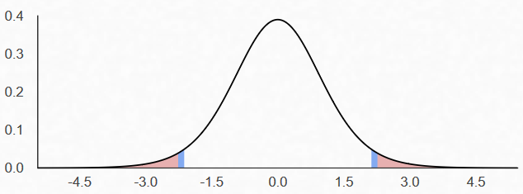
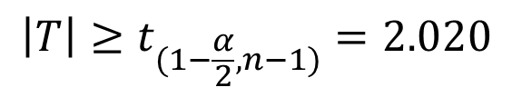
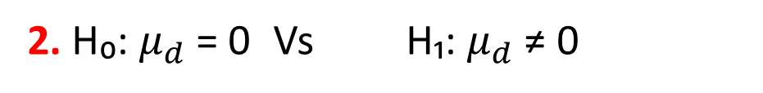
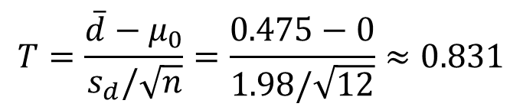
1. α = 0.05
2. H₀: $μ_{d}$ = 0 Vs H₁: $μ_{d}$ ≠ 0
3. Test Statistic:
$$T=\frac{\overline{d}−μ_{0}}{s_{d}/\sqrt{n}}=\frac{0.475−0}{1.98/\sqrt{12}}≈0.831$$
4. Rejection Region:
$$\left|T\right|≥t_{(1−\frac{α}{2},n−1)}=2.020$$
5. t = 0.831 is NOT in the rejection region, H₀ is NOT rejected
6. At 5% level of significance there is insufficient evidence to reject the null hypothesis and self-reported heights are statistically indifferent from measured heights
7. P-value = $P\left(T_{11}≤−0.83\right)+P\left(T_{11}≥0.83\right)=2∗tcdf\left(−99,−0.83,11\right)=0.414$

Slide 7

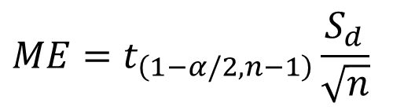




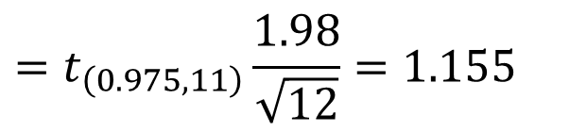
Same conclusion can be made using a 95% Confidence Interval:
$$n=12$$
$$\overline{d}=0.475$$
$$S_{d}=1.98$$
$$α=0.05$$
$$ME=t_{\left(1−α/2,n−1\right)}\frac{S_{d}}{\sqrt{n}}$$
$$=t_{\left(0.975,11\right)}\frac{1.98}{\sqrt{12}}=1.155$$
If the interval includes 0
then there is insignificant difference between X and Y scores
$$\left(\overline{d}−ME,\overline{d}+ME\right)=\left(0.475−1.155, 0.475+1.155\right)$$
$$={\left(−0.680, 1.63\right)}_{95\%}$$
We are 95% confident that the actual heights and the reported heights are statistically indifferent.
Notes:
$$t_{\left(0.975,11\right)}=invT\left(0.975,11\right)=2.20$$

Slide 8

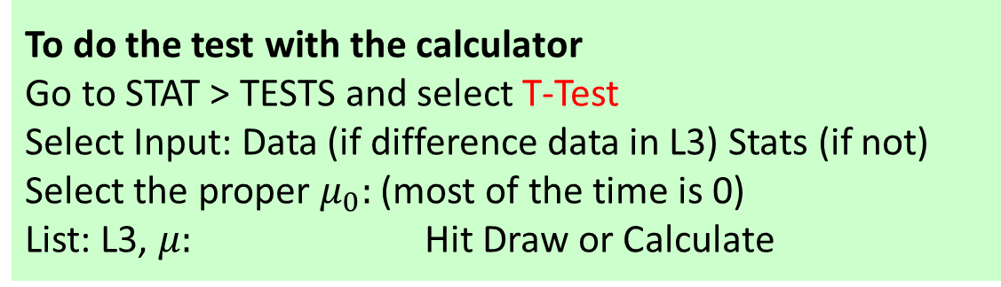
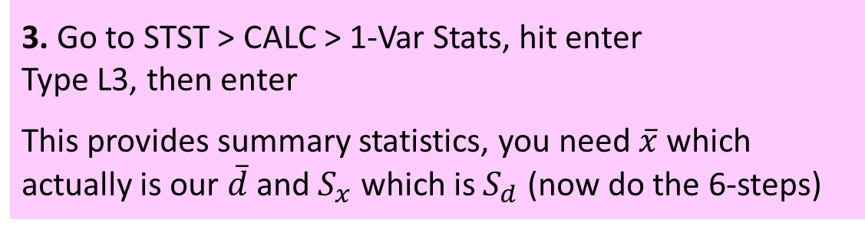
1. Enter data in X into L1 and Y into L2
Data is paired so do NOT change their order
2. Go to L3 and Enter L2 – L1, hit enter
This automatically computes the difference data
3. Go to STST > CALC > 1-Var Stats, hit enter
Type L3, then enter
This provides summary statistics, you need $\overline{x}$ which actually is our $\overline{d}$ and $S_{x}$ which is $S_{d}$ (now do the 6-steps)
To do the test with the calculator
Go to STAT > TESTS and select T-Test
Select Input: Data (if difference data in L3) Stats (if not)
Select the proper $μ_{0}:$ (most of the time is 0)
List: L3, $μ:$ Hit Draw or Calculate
Notes:
You can also use T-Intervals to build confidence intervals

Slide 9
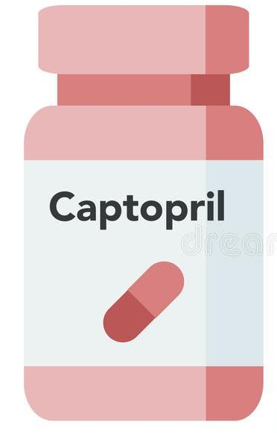
Ex2. Before/After Treatment Results
Captopril is a drug designed to lower systolic blood pressure. When subjects were tested with this drug, their systolic blood pressure readings (in mm Hg) were measured before and after the drug was taken, with the results given in the accompanying table.
Use the sample data to construct a 99% confidence interval for the mean difference between the before and after readings. Is there sufficient evidence to support the claim that captopril is effective in lowering systolic blood pressure?
Subject A B C D E F
Before: 200 174 198 170 179 182
After: 191 170 177 167 159 151
Subject G H I J K L
Before: 193 209 185 155 169 210
After: 176 183 159 146 146 177

Slide 10




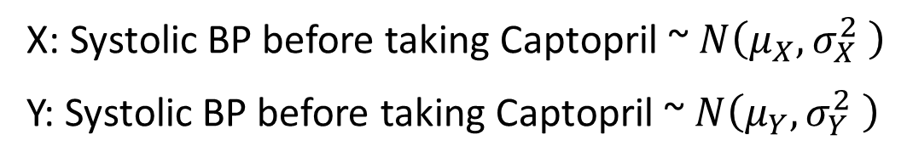

Subject A B C D E F
Before: 200 174 198 170 179 182
After: 191 170 177 167 159 151
Difference: 9 4 21 3 20 31
Subject G H I J K L
Before: 193 209 185 155 169 210
After: 176 183 159 146 146 177
Difference: 17 26 26 9 23 33
X: Systolic BP before taking Captopril ~ $N\left(μ_{X},σ_{X}^{2} \right)$
Y: Systolic BP before taking Captopril ~ $N\left(μ_{Y},σ_{Y}^{2} \right)$
Parameter of interest here is the mean difference BP (Before-After)
$$μ_{d}=μ_{X}−μ_{Y}$$
$$n=12$$
$$\overline{d}=18.5$$
$$s_{d}=10.18$$
Claim: Captopril lowers systolic BP
Alternative: no difference in BP before and after taking Captopril
$$μ_{0}=0$$

Slide 11

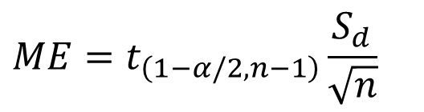



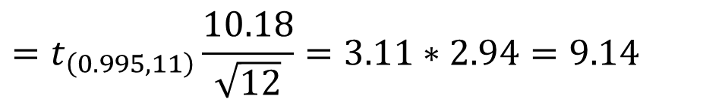
A 99% Confidence Interval:
$$n=12$$
$$\overline{d}=18.5$$
$$S_{d}=10.18$$
$$α=0.01$$
$$ME=t_{\left(1−α/2,n−1\right)}\frac{S_{d}}{\sqrt{n}}$$
$$=t_{\left(0.995,11\right)}\frac{10.18}{\sqrt{12}}=3.11∗2.94=9.14$$
$$\left(\overline{d}−ME,\overline{d}+ME\right)=\left(18.5−9.14, 18.5+9.14\right)$$
$$={\left(9.35, 27.64\right)}_{99\%}$$
Since the interval does not include 0, before measurements are significantly higher than after measurements, therefore,
We are 99% confident that the drug is effective in reducing BP
Notes:
$$t_{\left(0.995,11\right)}=invT\left(0.995,11\right)=3.1058$$

Slide 12
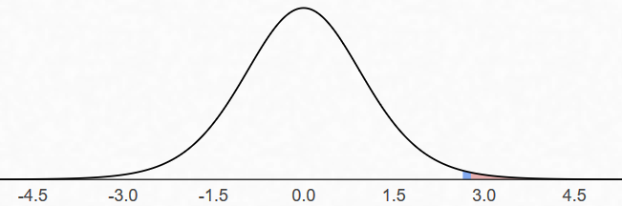


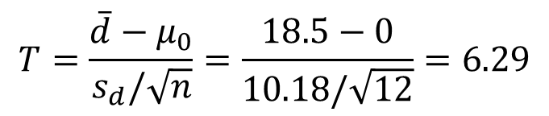
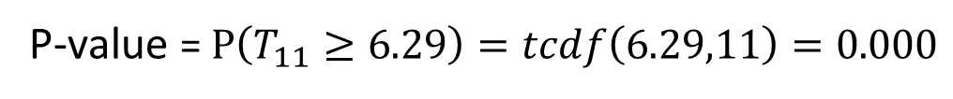
1. α = 0.01
2. H₀: $μ_{d}$ = 0 Vs H₁: $μ_{d}$ > 0
3. Test Statistic:
$$T=\frac{\overline{d}−μ_{0}}{s_{d}/\sqrt{n}}=\frac{18.5−0}{10.18/\sqrt{12}}=6.29$$
4. Rejection Region:
$$T≥t_{(0.99,11)}=2.71$$
5. t = 6.29 IS in the rejection region, H₀ is rejected
6. At 1% level of significance there is sufficient evidence to reject the null hypothesis and conclude that Captopril reduces systolic blood pressure
7.
P-value = $P\left(T_{11}≥6.29\right)=tcdf\left(6.29,11\right)=0.000$

Slide 13
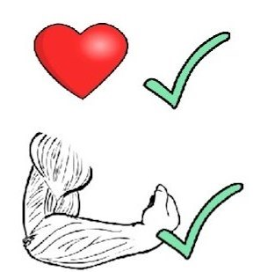
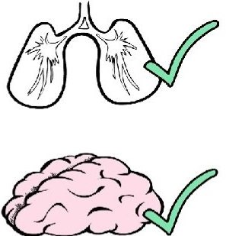
Ex3. Testing Effects of Physical Training
A study was conducted to investigate some effects of physical training. Sample data are listed below, with all weights given in kilograms. Is there sufficient evidence to conclude that there is a difference between the pretraining and post-training weights? What do you conclude about the effect of training on weight?
Construct a 95% confidence interval for the mean of the differences between pretraining and post-training weights.
Pretraining: 99 57 62 69 74
Post-training: 94 57 62 69 66
Pretraining: 77 59 92 70 85
Post-training: 76 58 88 70 84

Slide 14
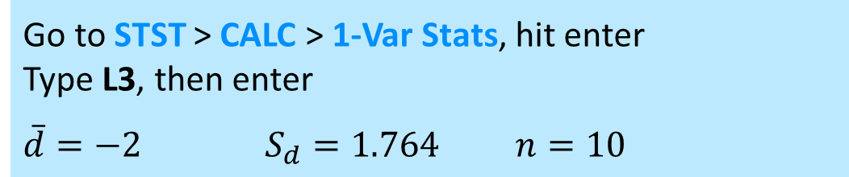
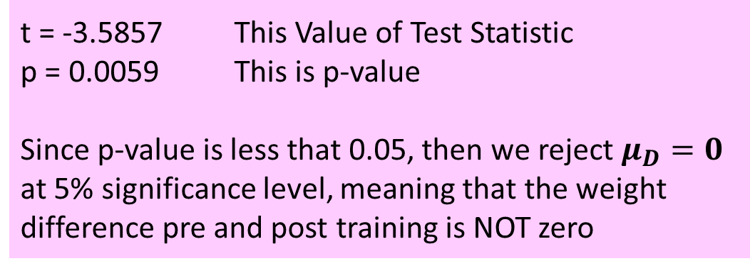
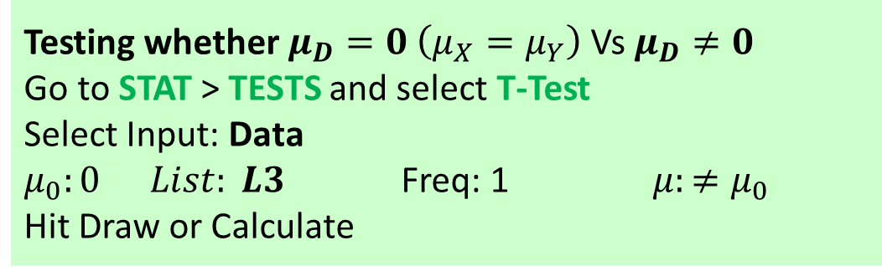
Pre-tr: Post-tr:
L1 L2
- - - - - - - - - - - -
99 94
57 57
62 60
69 68
74 70
77 75
59 58
92 88
70 70
85 84
Post-tr – Pre-tr
L3 = L2 – L1
- - - - - - - - - - - -
Go to STST > CALC > 1-Var Stats, hit enter
Type L3, then enter
$\overline{d}=−2$ $S_{d}=1.764$ $n=10$
-5
0
-2
-1
-4
-2
-1
-4
0
-1
Testing whether $μ_{D}=0$ $\left(μ_{X}=μ_{Y}\right)$ Vs $μ_{D}≠0$
Go to STAT > TESTS and select T-Test
Select Input: Data
$μ_{0}:0$ $List: L3$ Freq: 1 $μ:≠μ_{0}$
Hit Draw or Calculate
t = -3.5857 This Value of Test Statistic
p = 0.0059 This is p-value
Since p-value is less that 0.05, then we reject $μ_{D}=0$ at 5% significance level, meaning that the weight difference pre and post training is NOT zero

Slide 15


Practice Problems Part 1
1. The infamous researcher, Dr. Gnirips, claims to have found a drug that causes people to grow taller. The coach of the Basketball team at Brandon University has expressed interest but demands evidence.
Ten people are randomly selected from students at Brandon, their heights measured, the drug administered, and 2 hours later their heights remeasured. The results were as follows.
Assume that the change in height follows a Normal distribution.
Do we have sufficient evidence in the data to conclude that the drug works?
Subject A B C D E F G H I J
Pre-Drug: 68 69 74 78 70 66 71 70 71 65
Post-Drug: 70 69 75 78 73 69 72 73 72 66

Slide 16
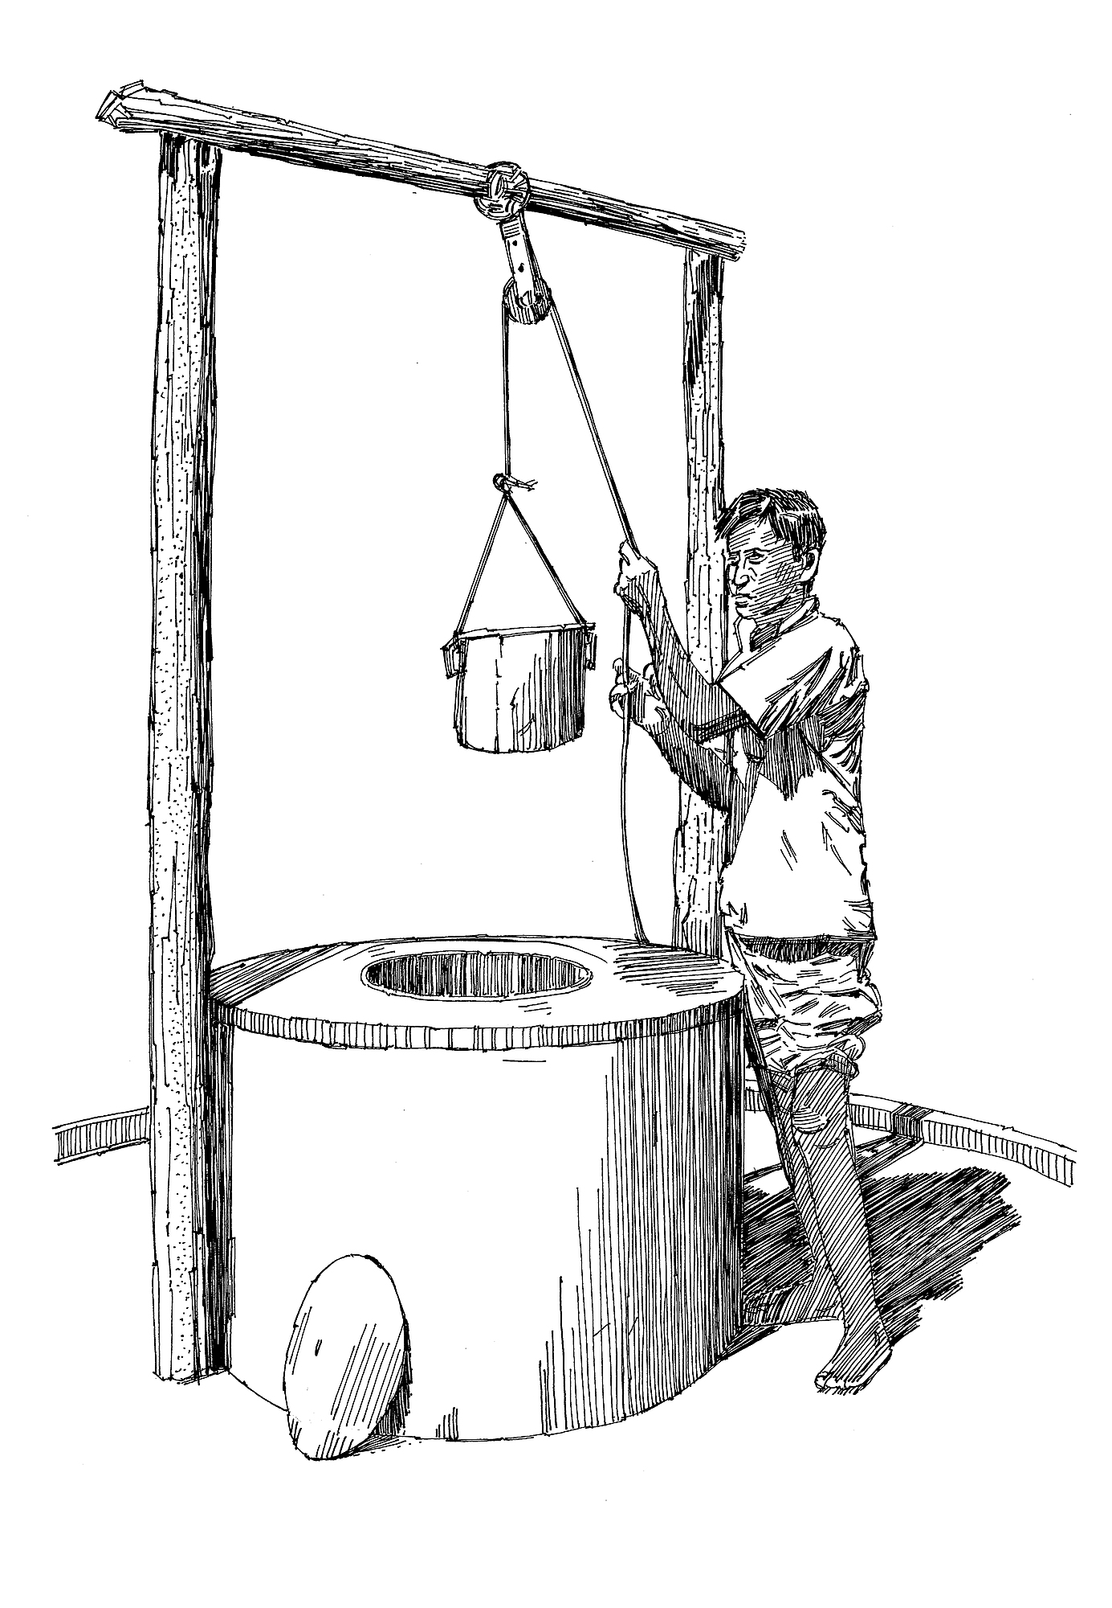
Practice Problems Part 1
2. Water in wells may vary in the concentration of the trace metals depending upon from where it is drawn. The trace metal concentrations (mg/L) on zinc were found from water drawn from the bottom and the top of 6 randomly selected wells*.
Assume that the trace metal concentrations follow a Normal distribution. Construct a 95% confidence interval for the mean difference in the zinc concentrations between water drawn from the top and bottom of wells, make a conclusion.
Location 1 2 3 4 5 6
Bottom: 0.430 0.266 0.567 0.531 0.707 0.716
Top: 0.415 0.238 0.390 0.410 0.605 0.609
* Trace Metals of South Indian River Region, Environmental Studies, 1982, 62-69.

